Slide 1
ABOUT TURKEY
Young Population
Economic Size
Geopolitical Position
Logistic Advantage
Investment Opportunities

Slide 3
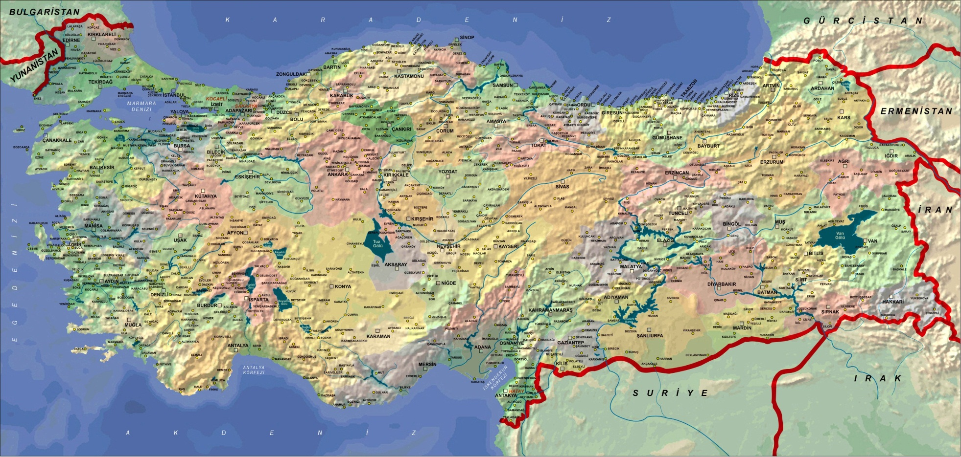
ABOUT TURKEY
NEAR EUROPE & NEAR ASIA

Slide 4
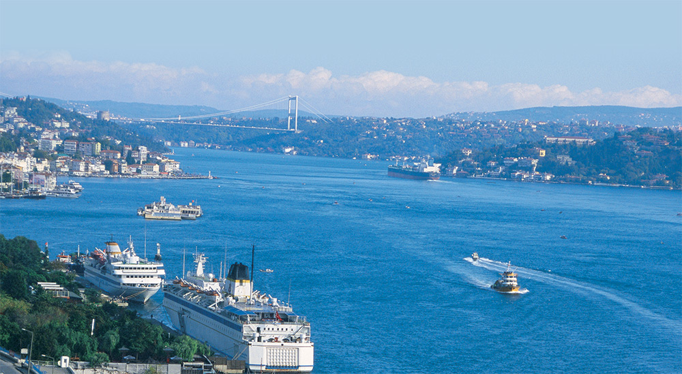

Slide 5
ABOUT TURKEY
81 CITIES

Slide 6
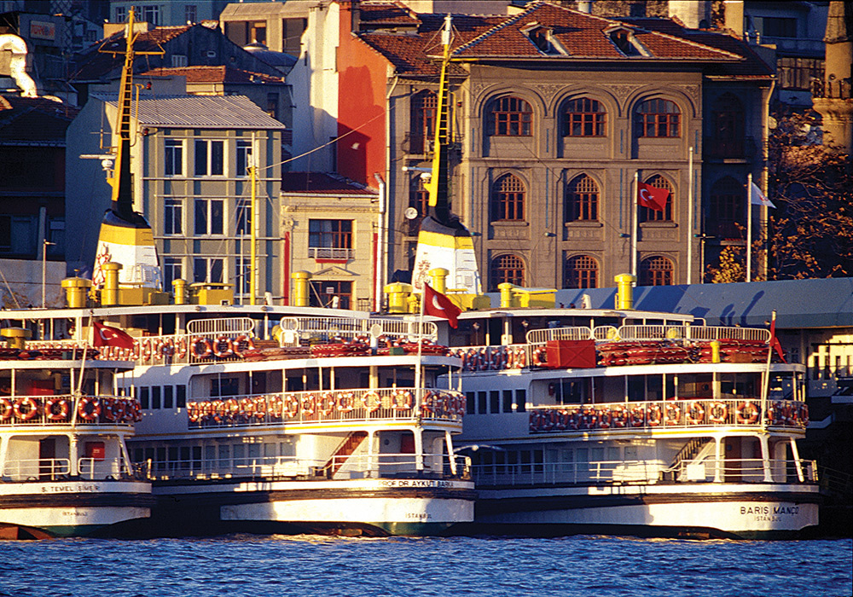
ABOUT TURKEY

Slide 7
ABOUT TURKEY
EVERYWHERE IS BEATIFUL

Slide 8
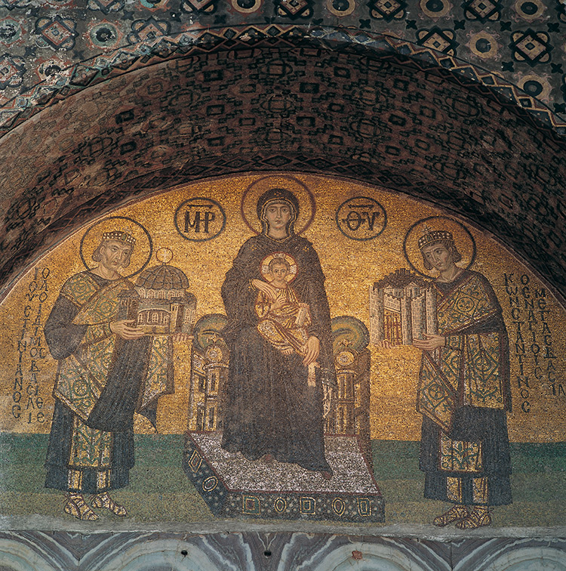

Slide 9
ECONOMY & COMPANIES
Number of Companies: 1.500.000
Number of Foreign Companies: 36.450
National Income: 820 Billion $
National Income/individual: 10.800 $
Growth Rate: 4%

Slide 10
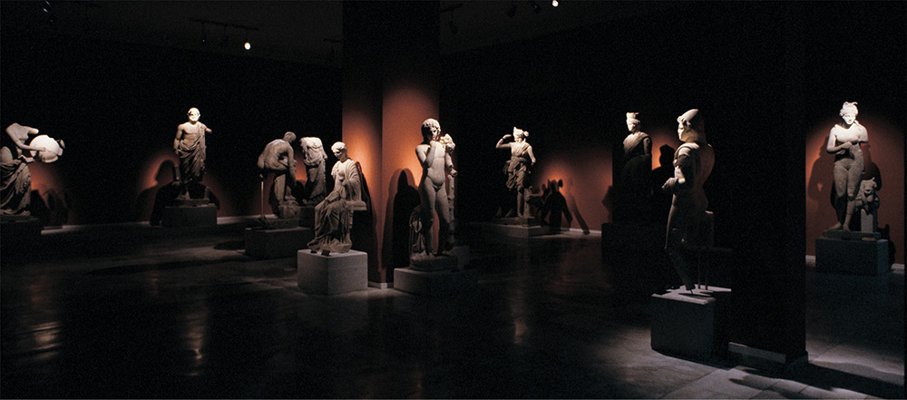

Slide 11
POPULATION
Population - 2011 : 74.525.696
Population - 2013 : 76.667.864

Slide 12
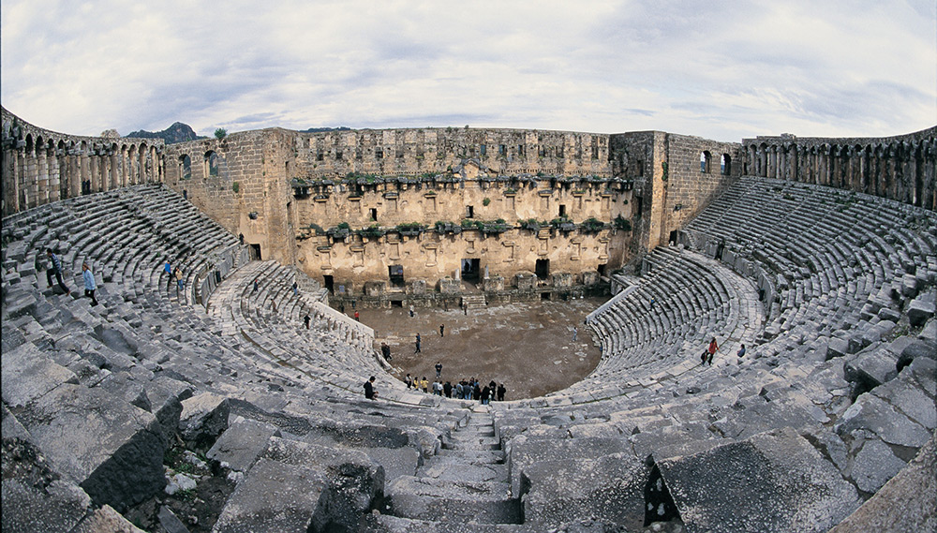

Slide 13
POPULATION from 1927 to 2013
Population Growth: from 1927 to 2013 62.000.000
2050 = 95.000.000

Slide 14
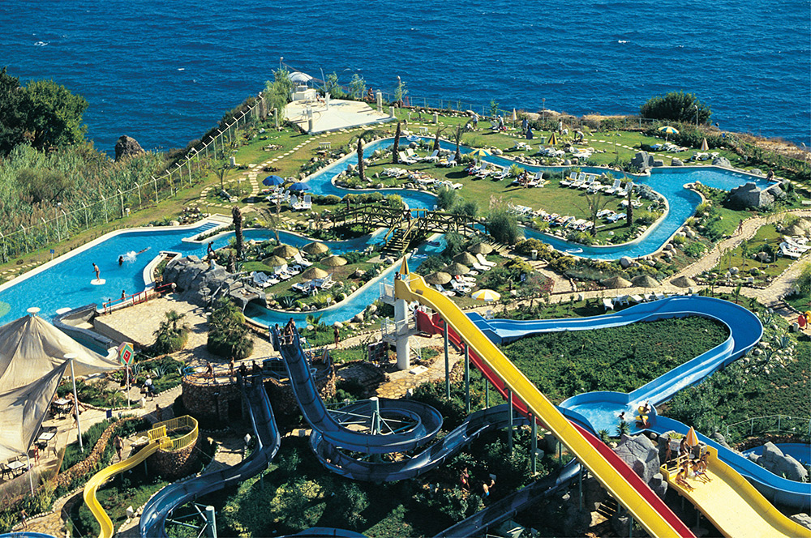

Slide 15
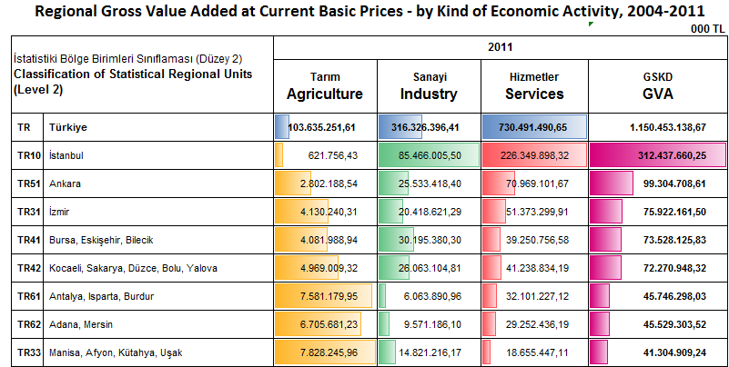
ECONOMIC TERRITORIES ACCORDING TO THE CITIES AND REGIONS
Ecomonic Intensity: Istanbul - Ankara - Izmir

Slide 16
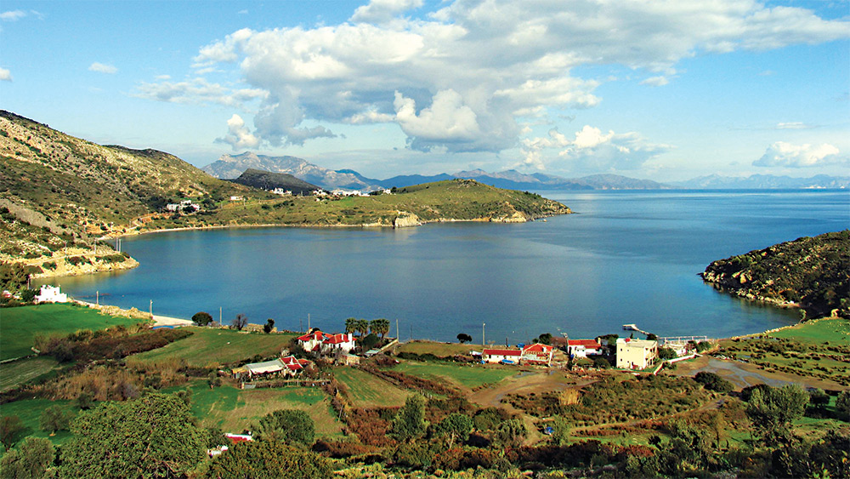

Slide 17
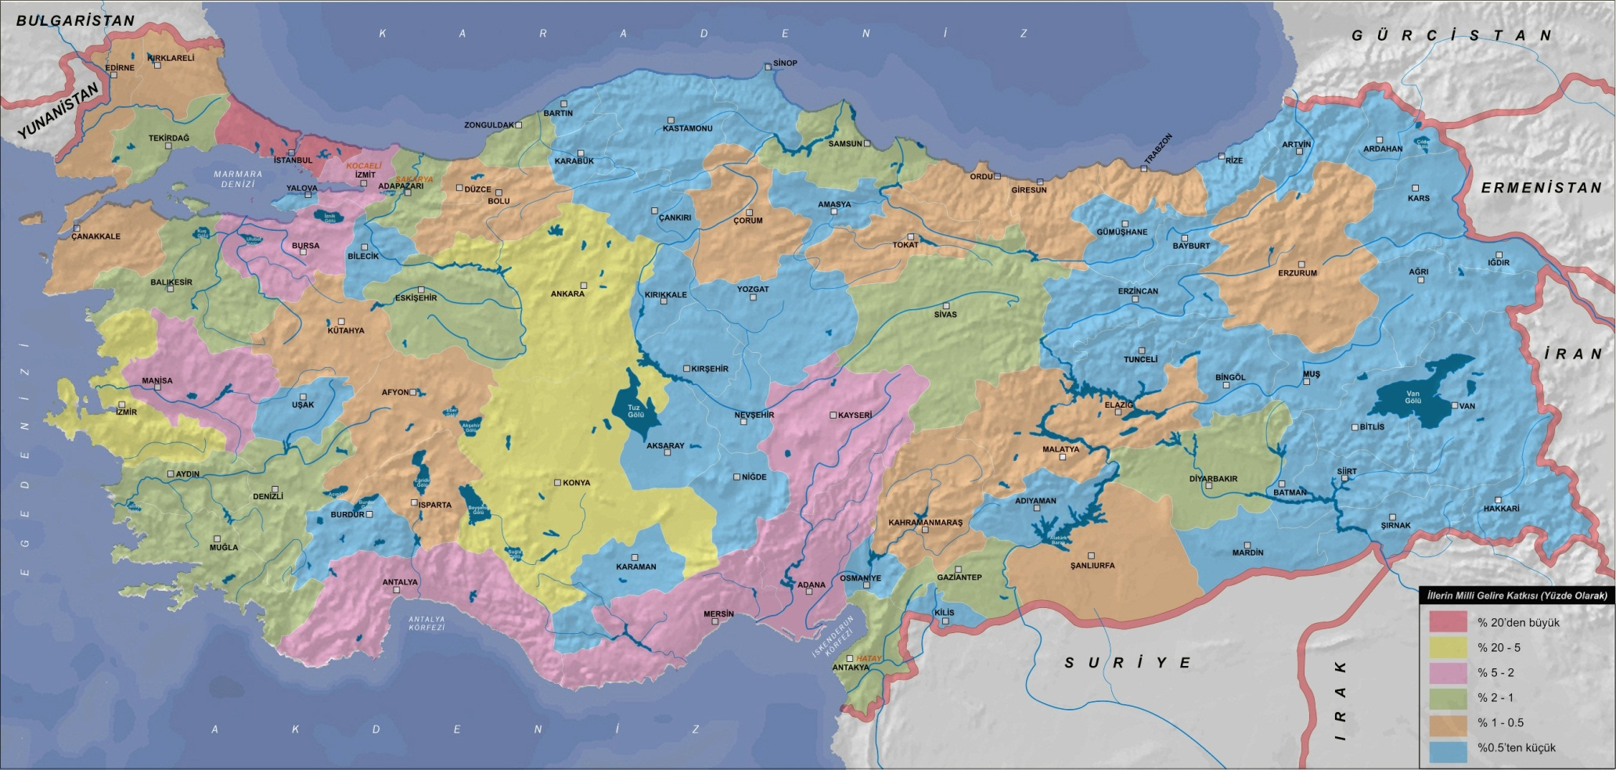
Services : %65
Industry: %25
Agriculture : %10
Service
Industry,
Agriculture
Service
Industry
Logistic
Industry
Industry
Industry
Agriculture
Logistic
Industry
Agriculture
Agriculture
Logistic
Industry
Agriculture
Industry
Agriculture
servıces
Industry
Industry
Agriculture
Agriculture
Agriculture
Agriculture
Industry
Logistic
Tourism
Industry
Agriculture
Industry
Agriculture
Agriculture
TOURISM
Agriculture
Tourism
Agriculture
Agriculture
industry
Agriculture
Tourism
Tourism
Tourism
Logistic

Slide 19
INFORMATION ABOUT EXPORT
Total Export: 151 billion $
Most of the exports are done to:

Slide 20
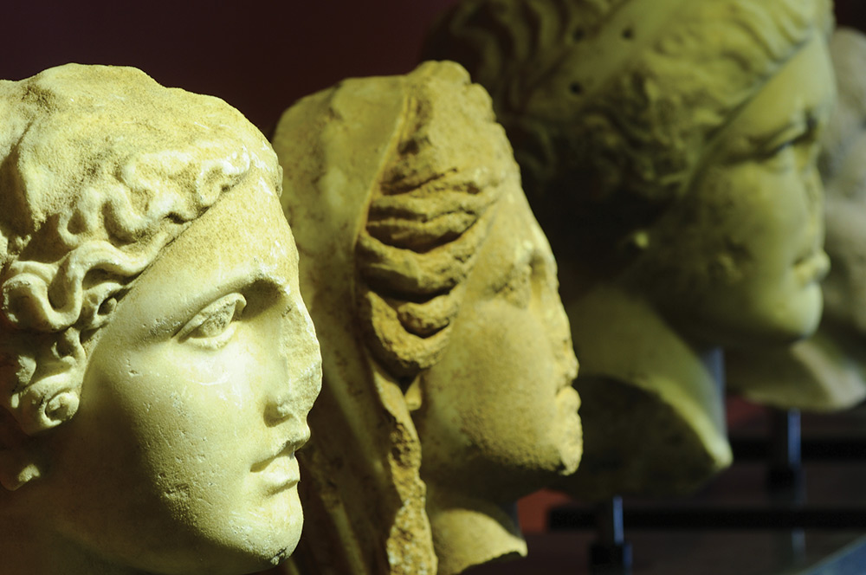

Slide 21
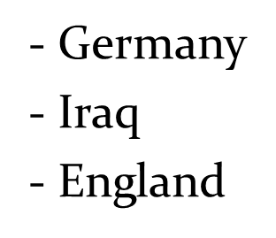
INFORMATION ABOUT EXPORT
The first 3 countries, which exports are done:

Slide 22
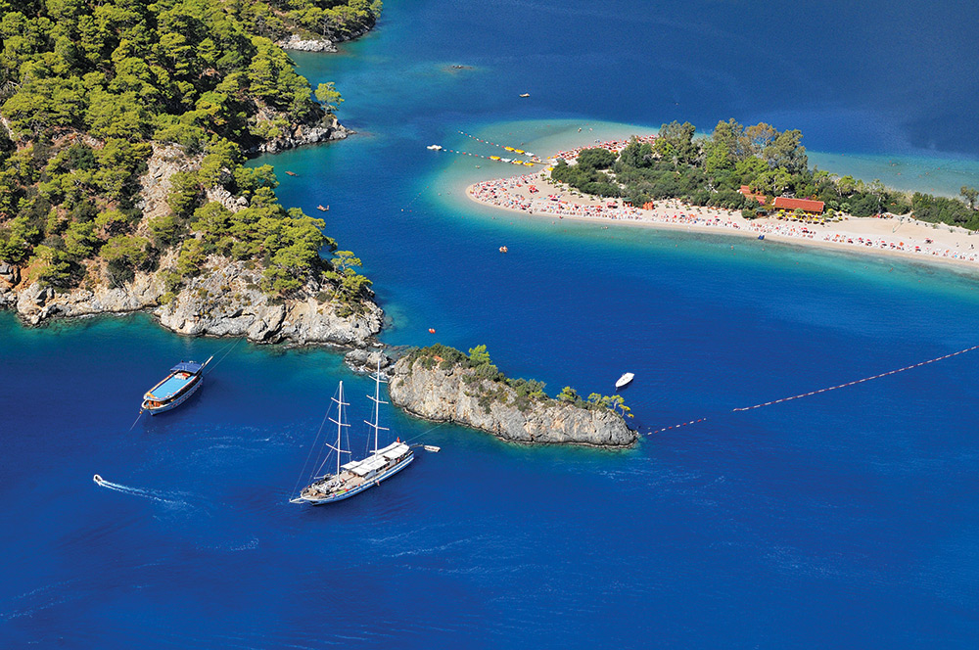

Slide 23
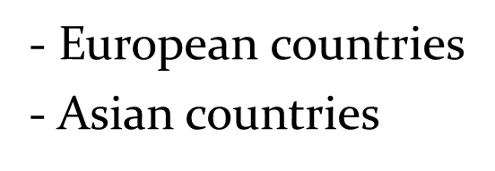
INFORMATION ABOUT IMPORT
Import=250 billion $
Most of the imports are come from:

Slide 24
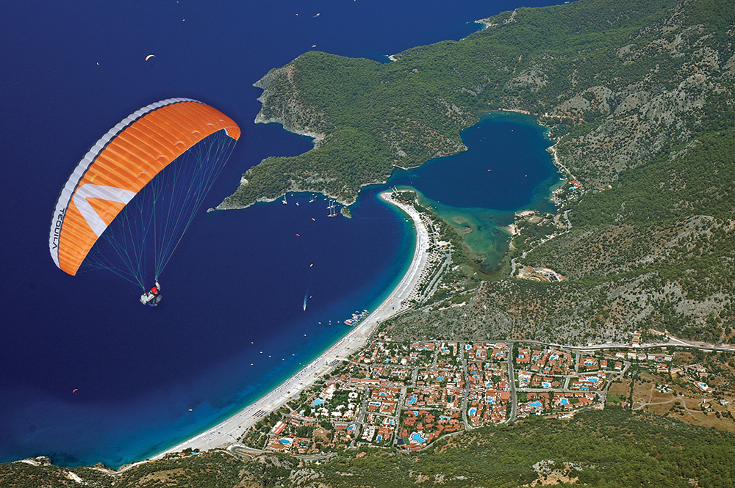

Slide 25
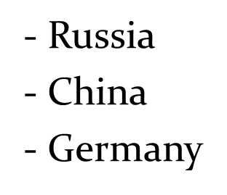
INFORMATION ABOUT IMPORT
The top 3 countries in import:

Slide 26
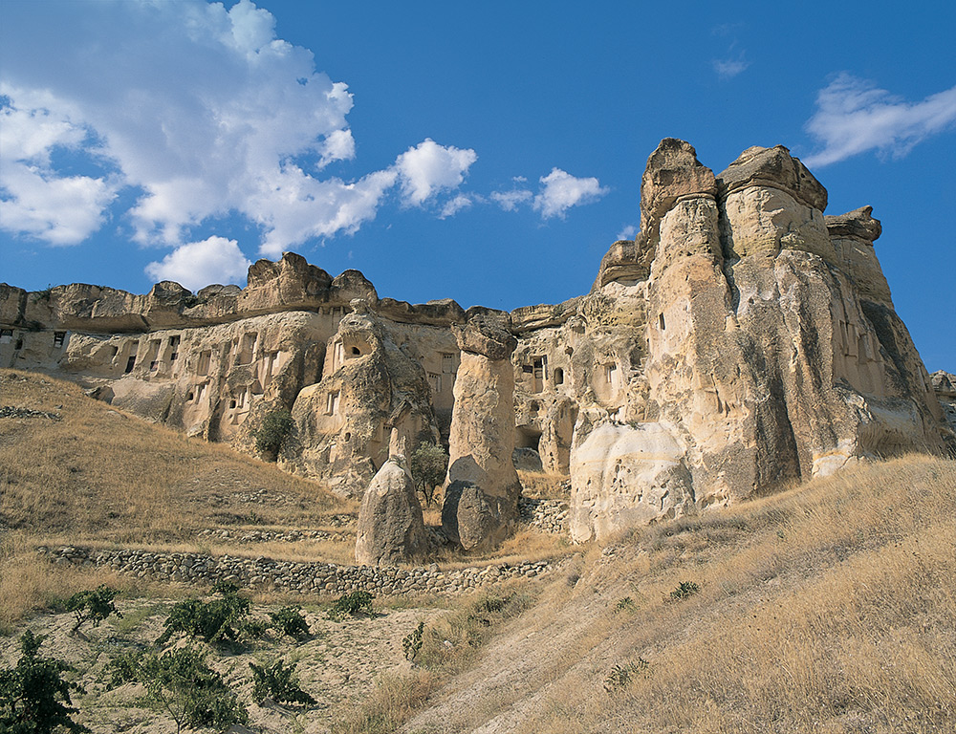

Slide 27
FOREIGN TRADE OF TURKEY, BASED ON YEARS

Slide 28
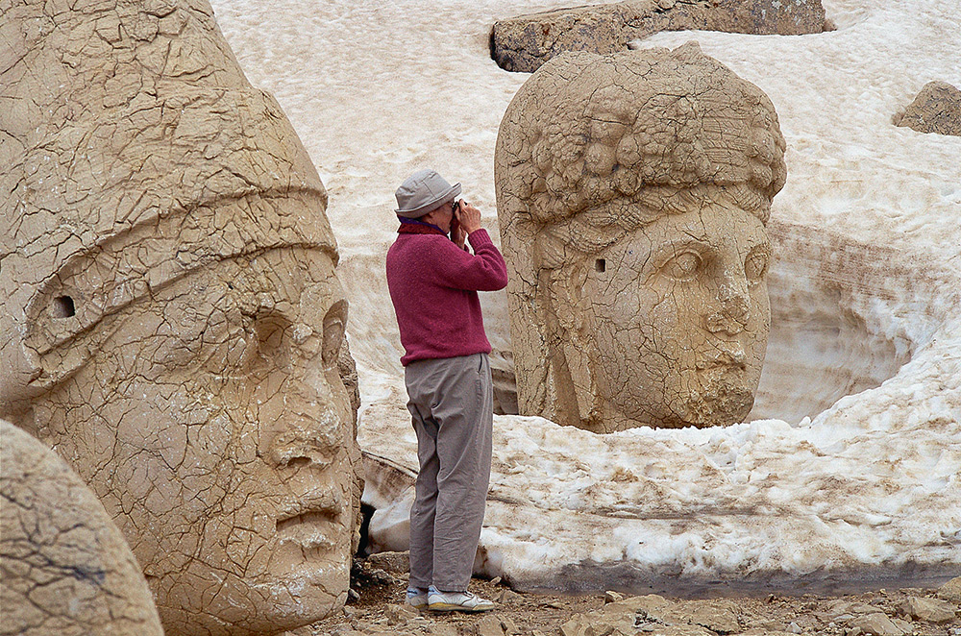

Slide 29
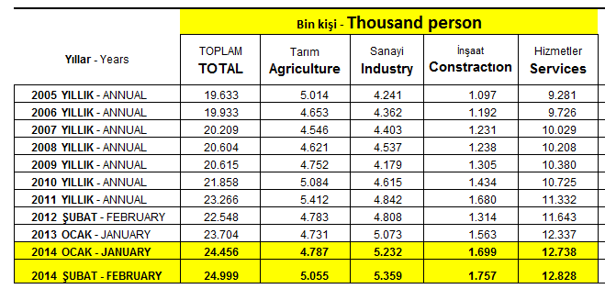
INFORMATION ABOUT EMPLOYMENT IN TURKEY
Labour force : 25 million people
Unemployment rate: 10%

Slide 30
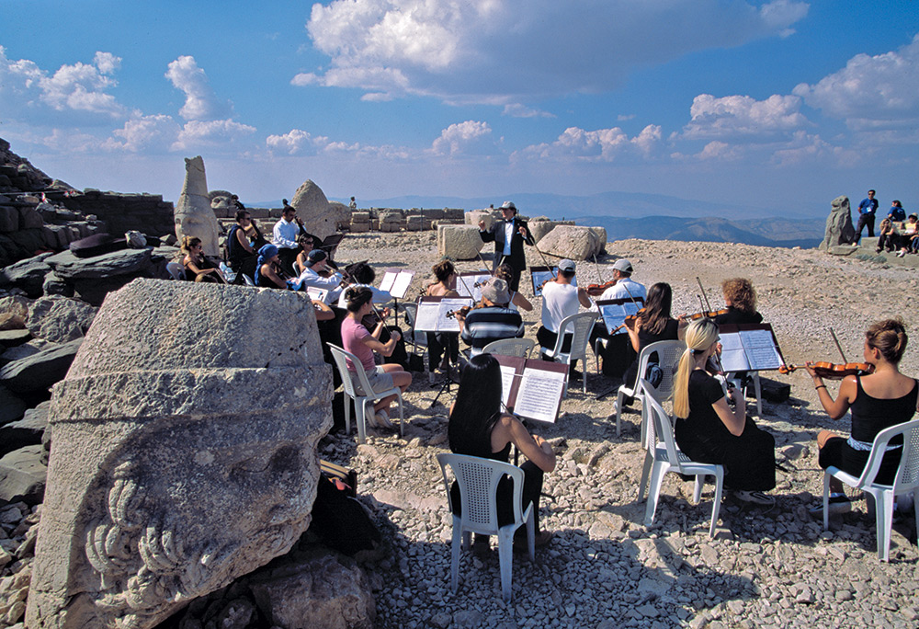

Slide 31
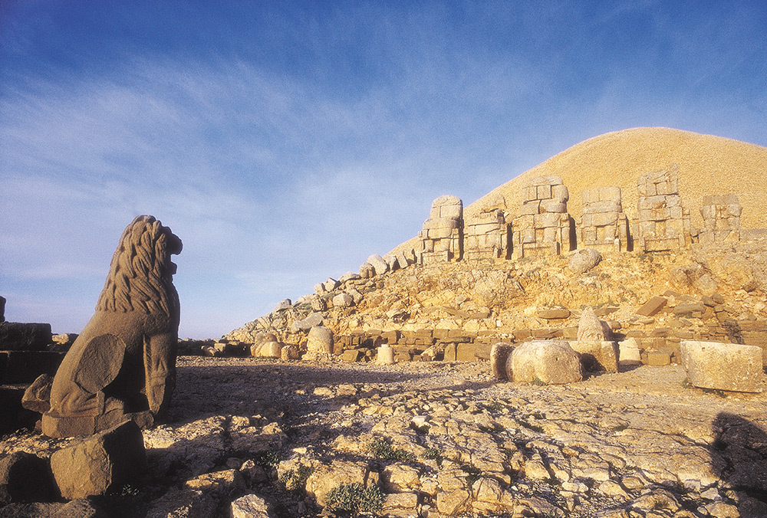

Slide 32
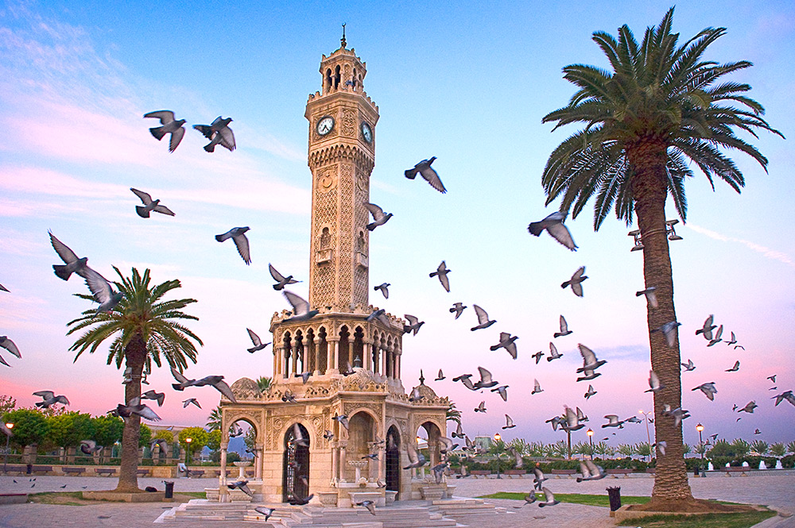

Slide 34
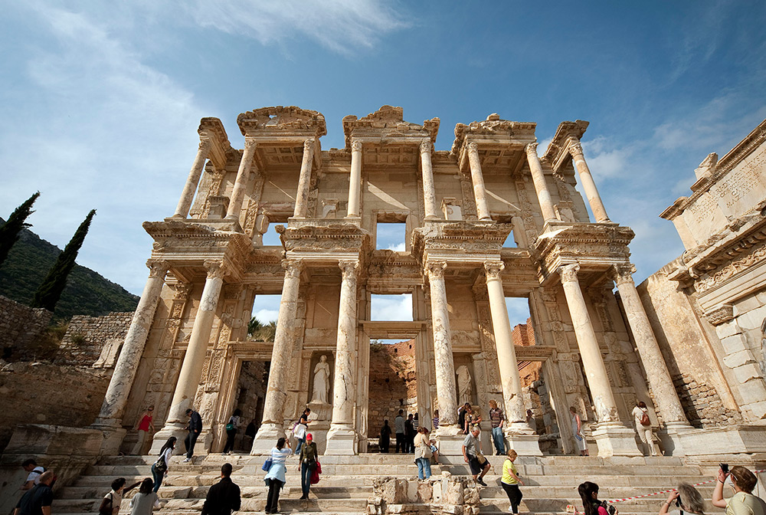

Slide 35
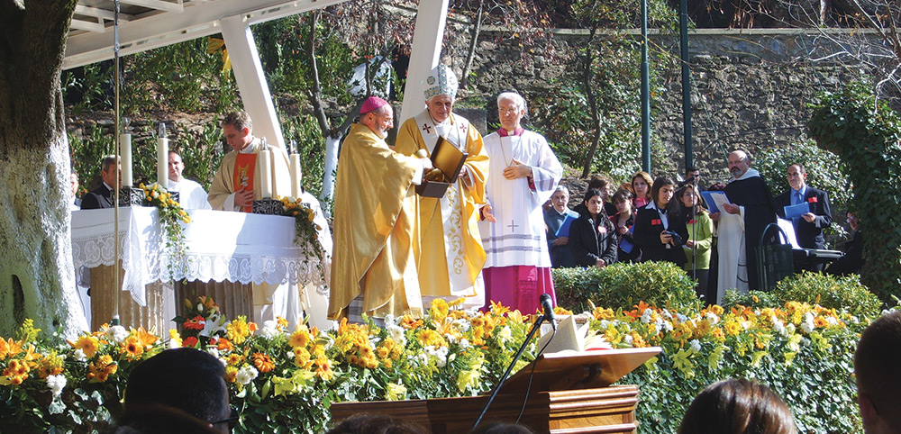
Poppa in İzmir

Slide 36
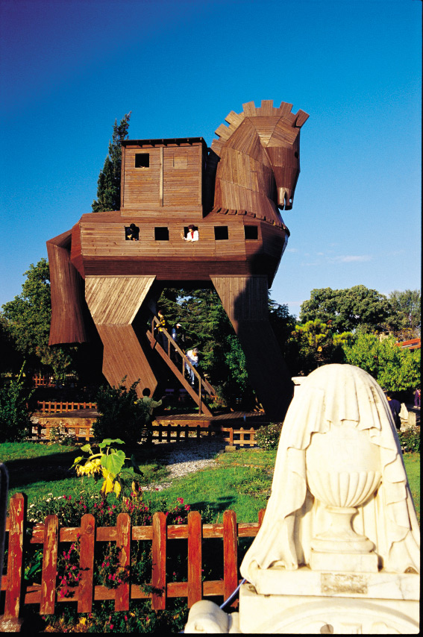
Trojan Horse - Çanakkale

Slide 37
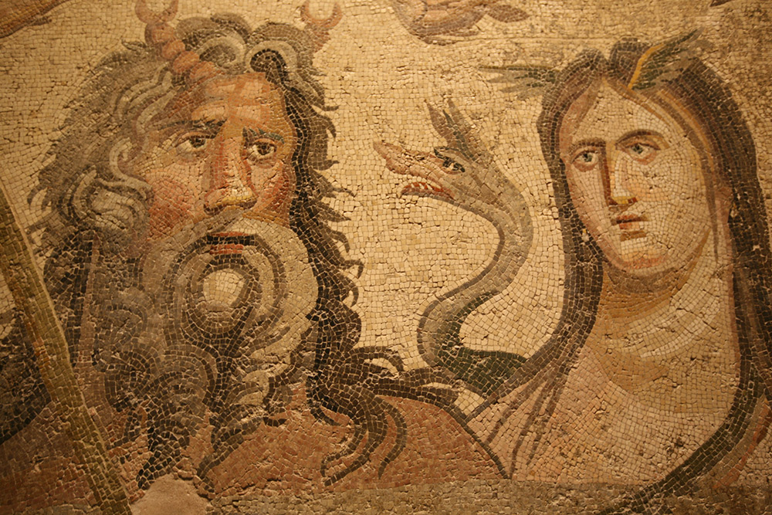
Zeugma - Gaziantep

Slide 38
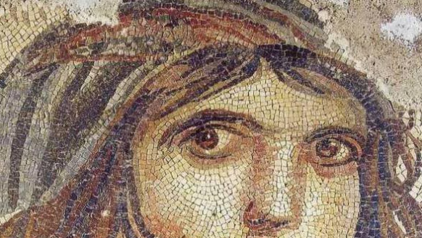
Zeugma - Gaziantep

Slide 39
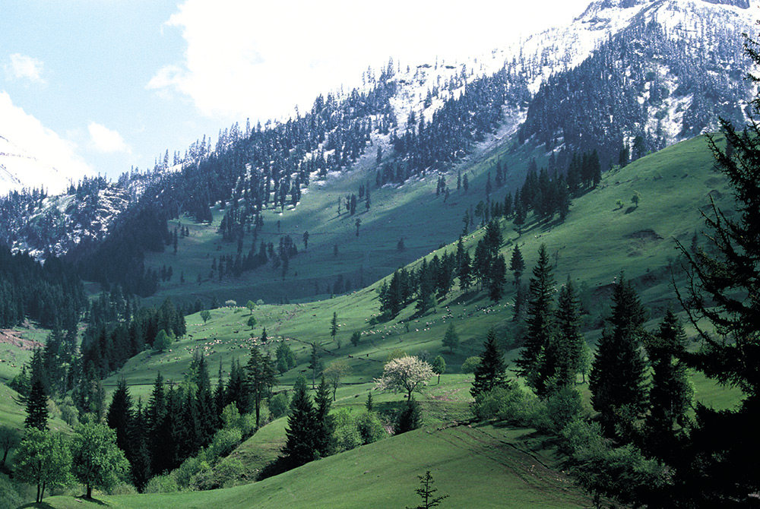
Trabzon

Slide 40
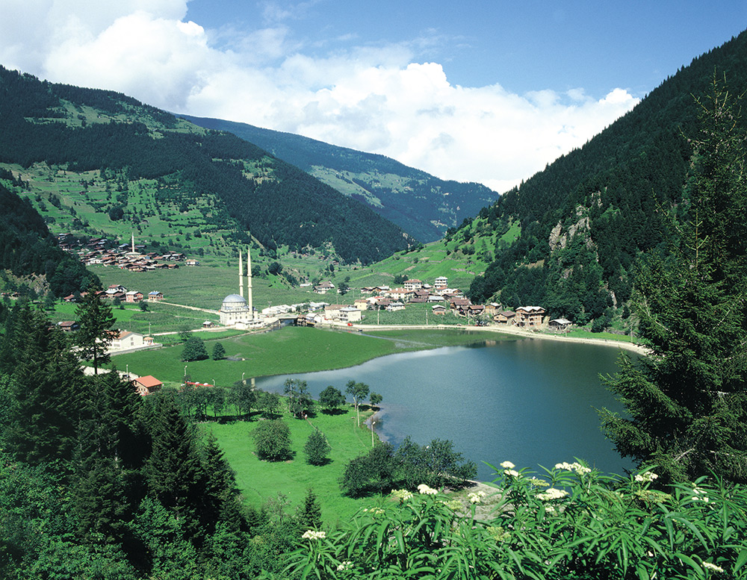

Slide 41
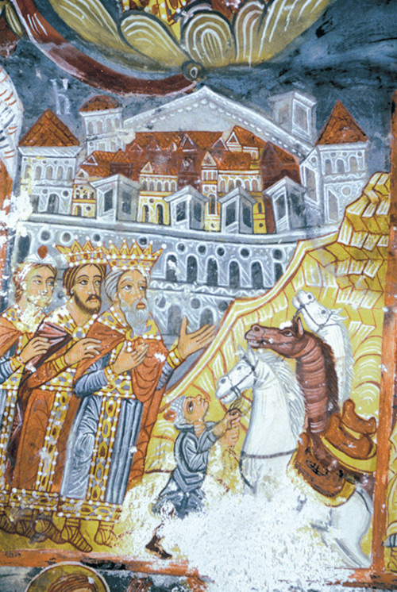

Slide 42
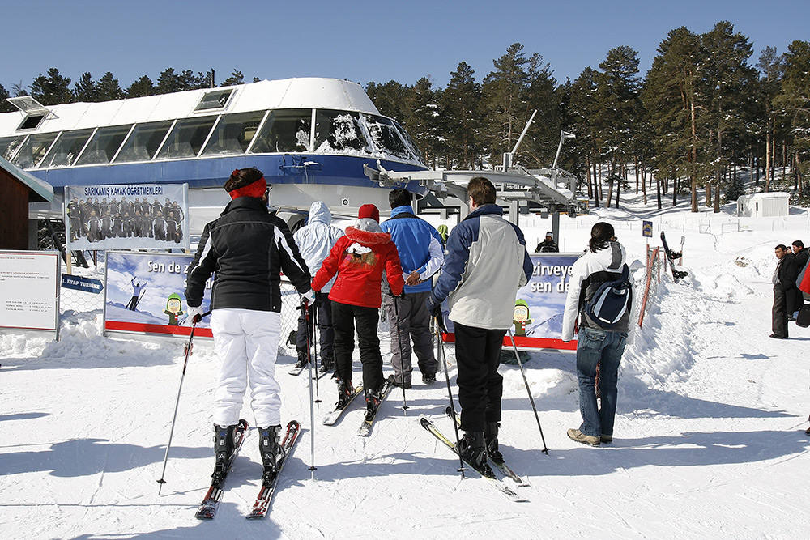

Slide 44
